Slide 1

NextEra Energy
Primer For Internal Use
Prepared by Youssef Chebbi
24/02/2025

Slide 2
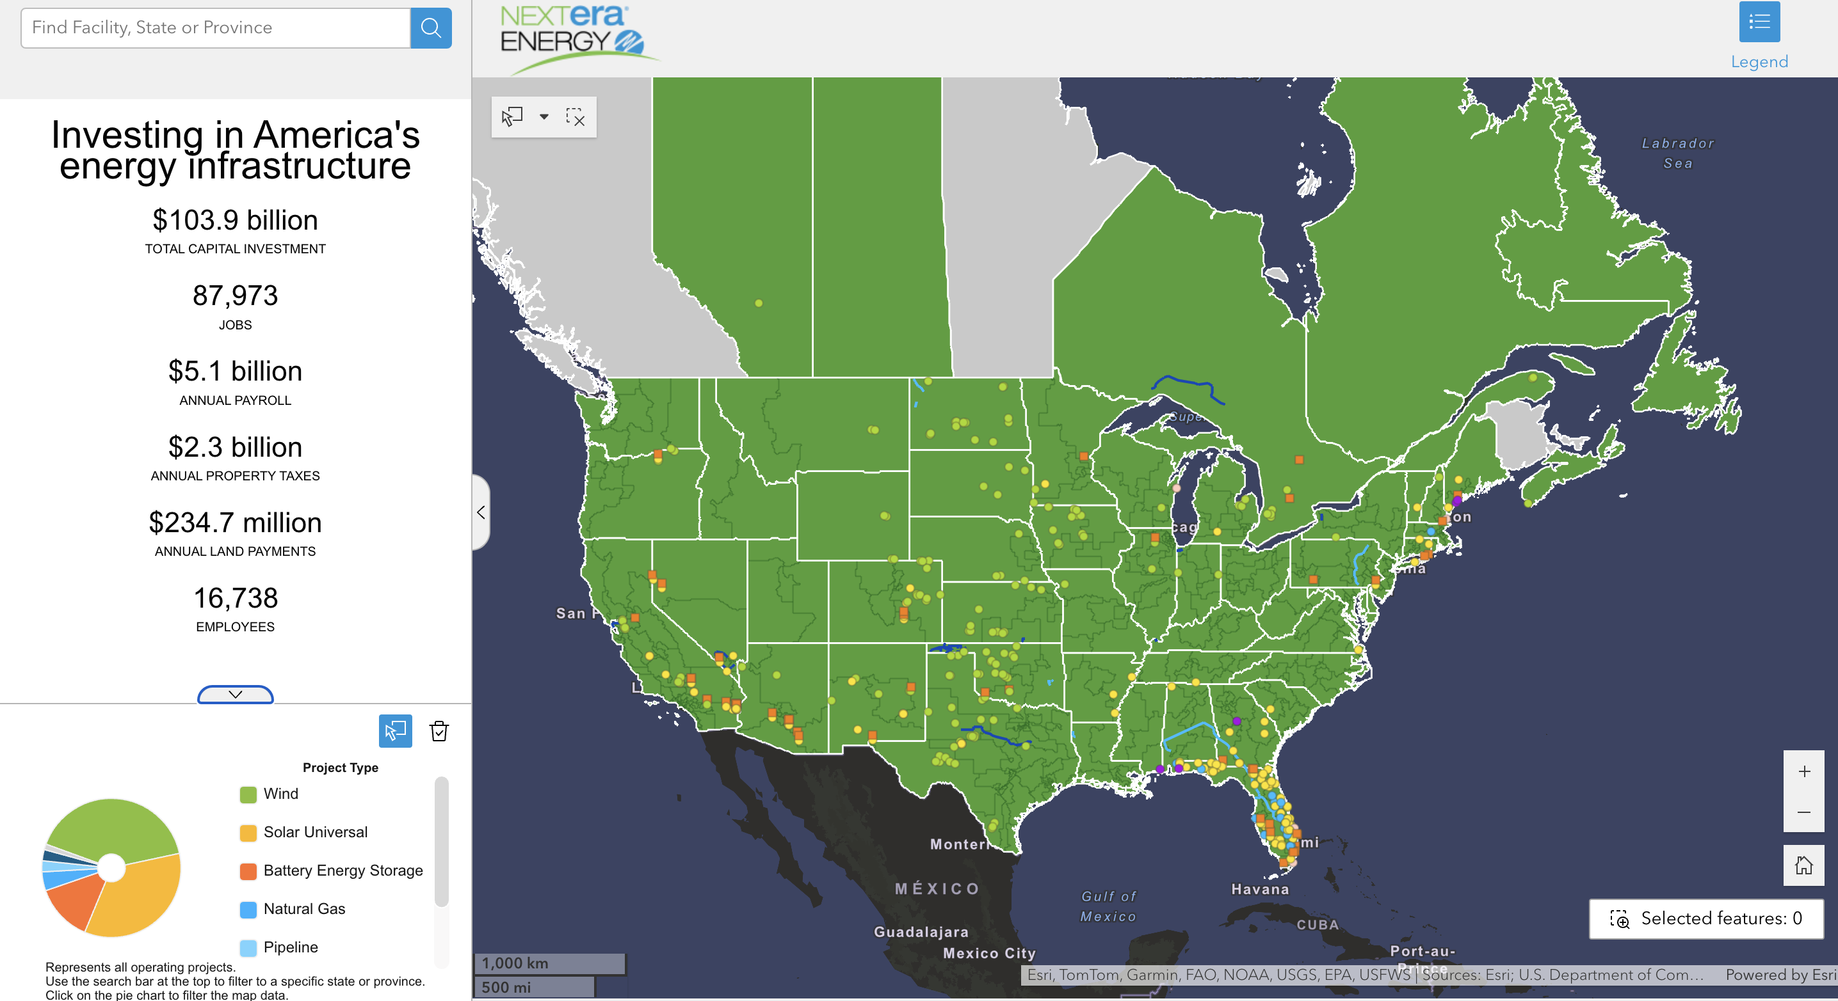
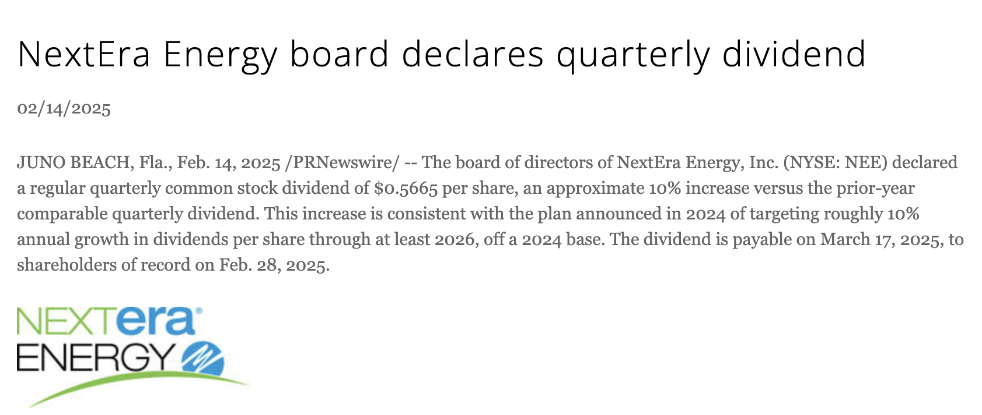
Company overview
Founded: 1984
Headquarters: Juno Beach, Florida, USA
Market Cap: $145 billion
Key Business Focus: Renewable Energy, Utilities, and Infrastructure
Mission: ”To be the largest clean energy provider in the world”
Stock Ticker: NEE (NYSE)
Employees: Over 16,000

Slide 3
Vision and values
Mission Statement: Drive a sustainable energy future with a commitment to innovation, clean energy, and operational excellence
Vision Statement: Lead the transformation of the energy sector by advancing clean and reliable energy solutions
Values:
- Committed to Excellence
- Do the Right Thing
- Treat People with Respect

Slide 4
Services
Florida Power & Light (FPL): Largest electric utility in Florida, serving ~6 million customers.
NextEra Energy Resources (NEER): Leading renewable energy provider (wind, solar, battery storage).
Infrastructure Investments: High-voltage transmission, hydrogen power, and battery storage projects.
Energy Trading & Wholesale Power: Strategic power supply services to utilities and large corporations.

Slide 5
Market position & competitive advantage
Renewable Energy Leadership: NextEra Energy is the world's largest producer of wind and solar energy.
Strong Market Position: Competes with major players like Duke Energy and Dominion Energy.
Growth Potential: Expanding its renewables portfolio with increasing demand for clean energy solutions.
Technology & Innovation: Investments in AI-driven energy solutions, battery storage, and hydrogen power.
Regulatory Positioning: Benefiting from clean energy policies and tax incentives.

Slide 6
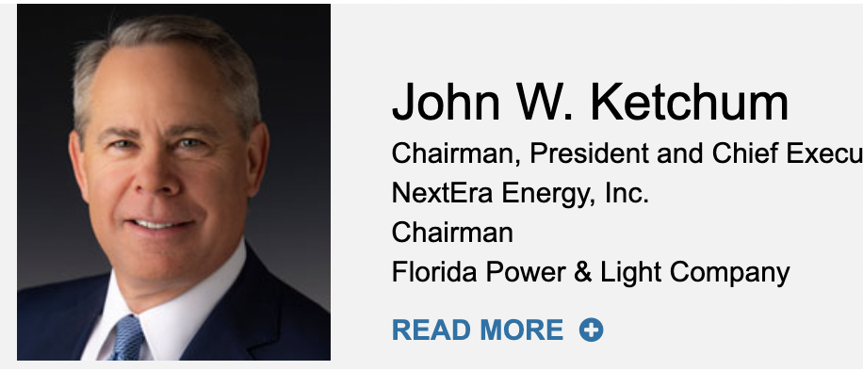
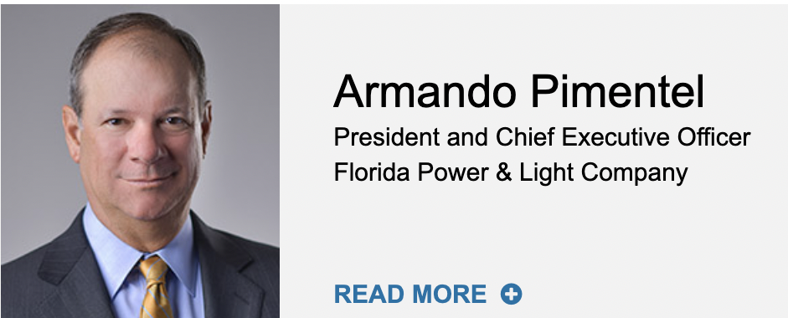
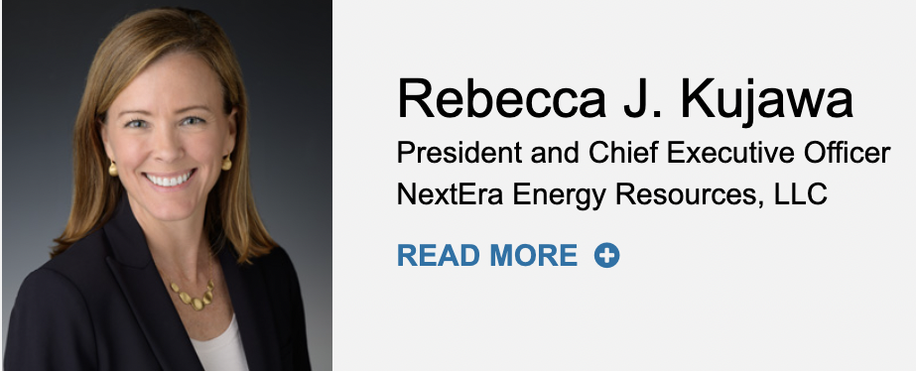
leadership
John W. Ketchum – CEO & President
Rebecca J. Kujawa – CFO
Armando Pimentel – CEO, FPL

Slide 7
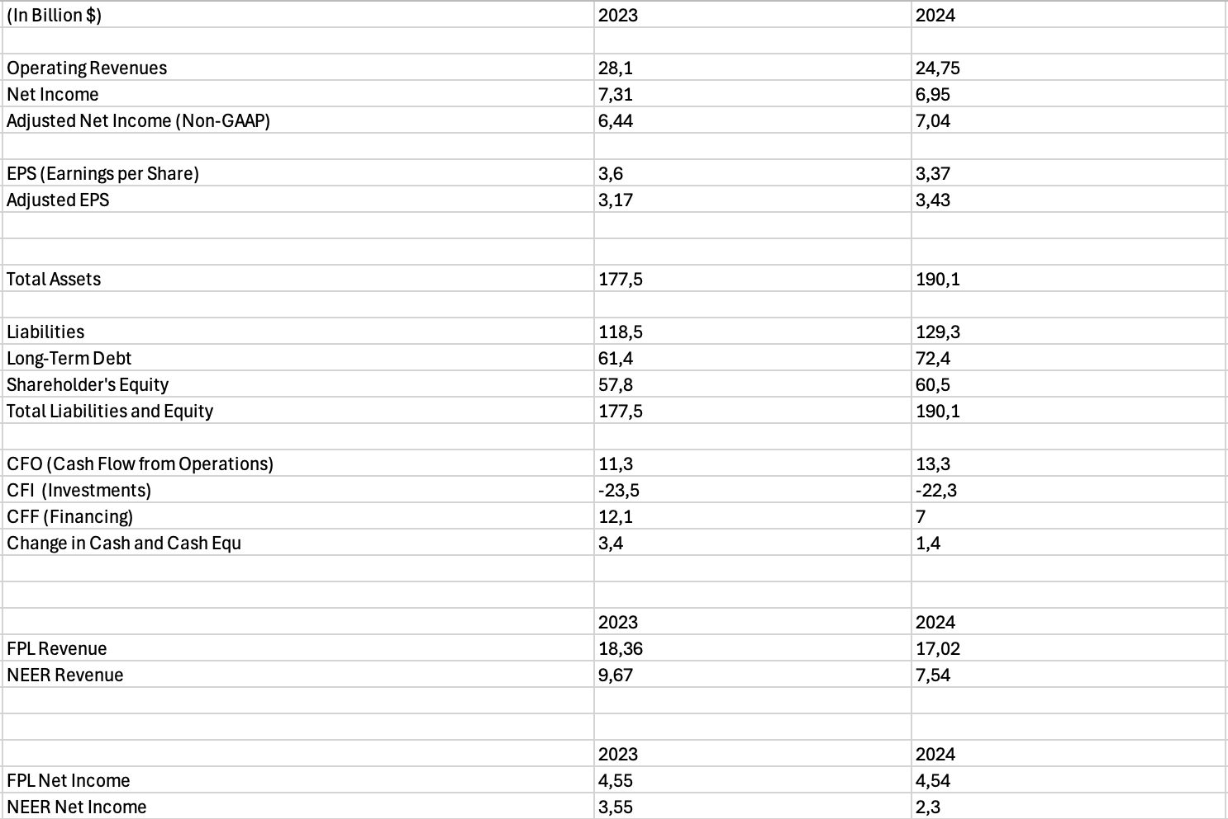
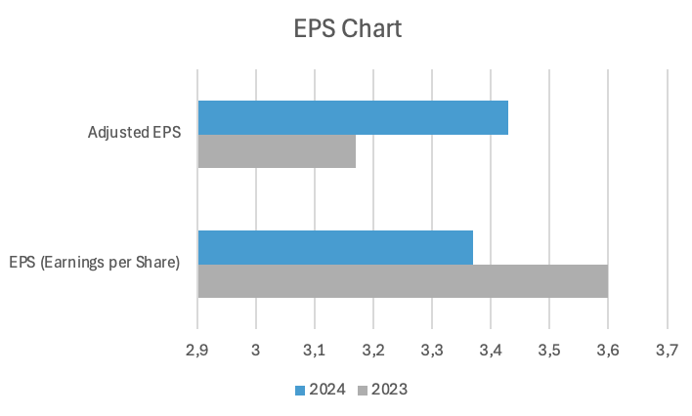
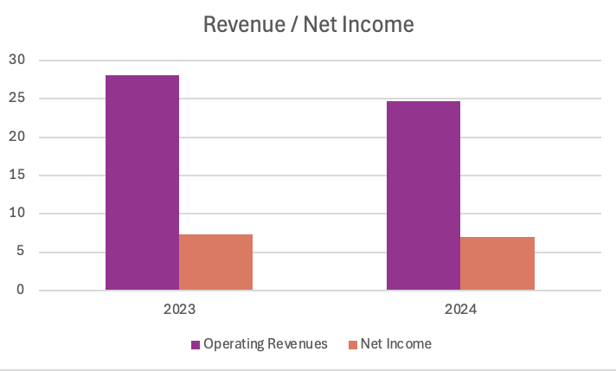
Financial Performance

Slide 8
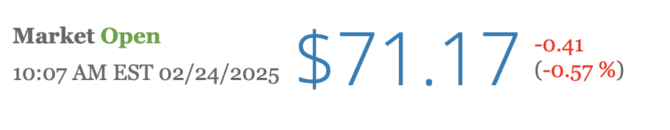
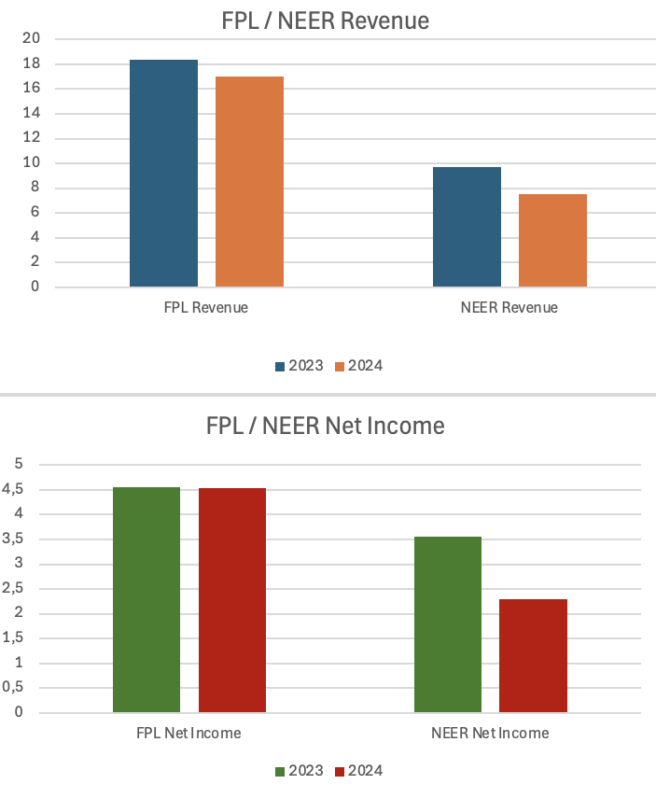
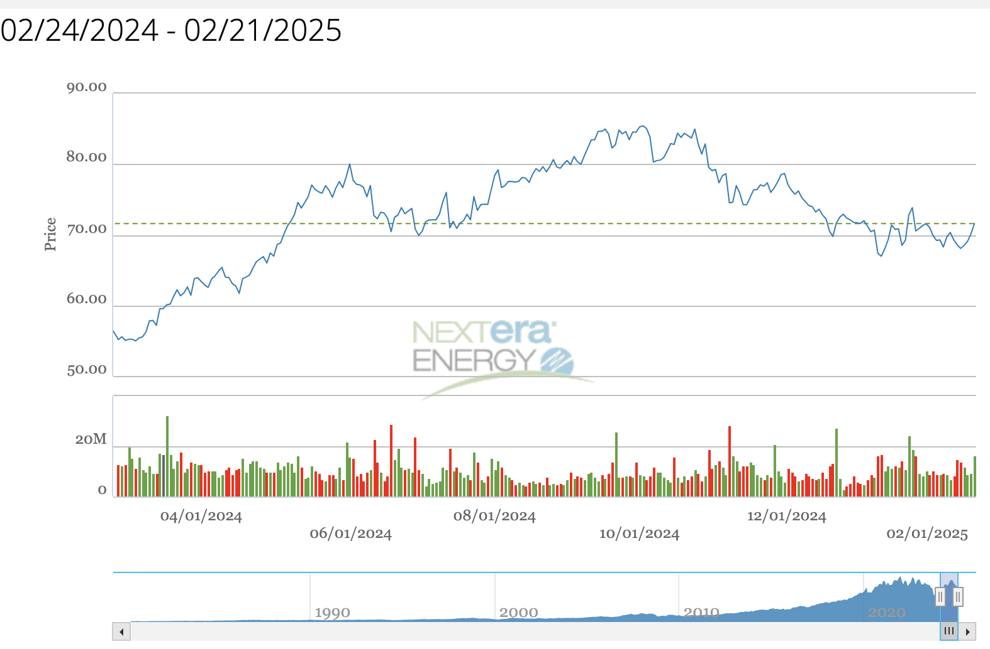
Business model & stock performance

Slide 9
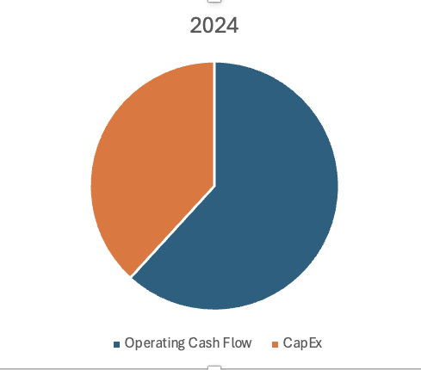
Cash flow & investment overview
Operating Cash Flow (2024): $13.26 Billion (↑ from $11.3B in 2023).
Capital Expenditures: $8.2 Billion (Renewables & Grid Expansion).
Debt Levels: Increased from $61.4B to $72.4B (due to expansion).
Dividend Growth: 10% increase, reflecting strong investor returns.

